Slide 1

A Machine Learning Approach to Understanding Older Adults’ Trust in Assistive Robots
Saathveek Gowrishankar
Dr. Samuel Olatunji, Dr. Wendy Rogers
Notes:
Welcome! This PowerPoint was originally created as a visual aid for my 10-minute presentation at the University of Illinois Urbana-Champaign Undergraduate Research Symposium in April 2024. I’ve included additional context and explanations in the speaker notes that may not be visible on the slides themselves.
If you have any questions or would like to learn more, feel free to reach out!

Slide 2
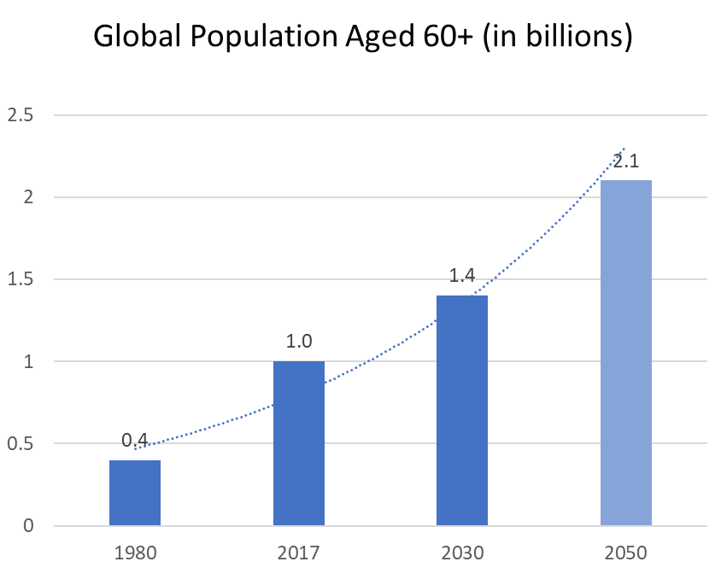
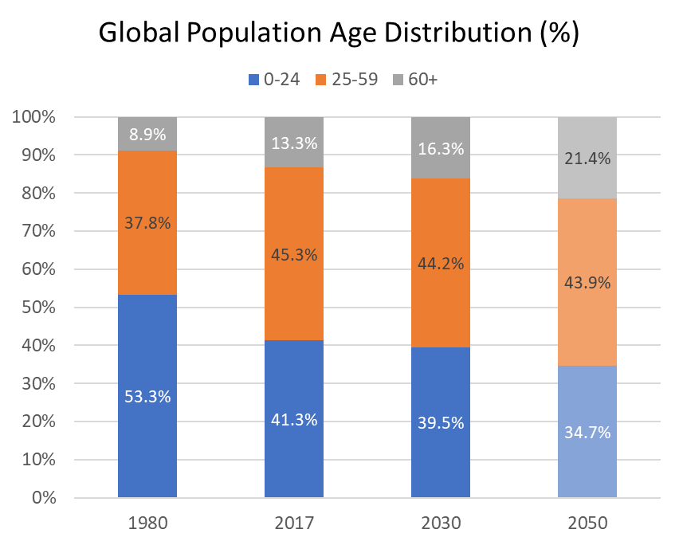
Older Adult Population Trends
United Nations World Population Prospects 2017
Notes:
This slide highlights the rapid growth of the global population aged 60 and older.
The left graph shows the projected increase in the number of older adults in the coming years.
The right graph illustrates that the older adult population is growing at a faster rate than the total population, signaling significant demographic shifts.

Slide 3

Aging in Place
Older Adults
prefer to remain in their own homes as they age
Notes:
As the older adult population continues to grow, there is increasing demand for solutions that support aging in place - the ability for older adults to live independently and safely at home. Among the many technologies available, assistive robots are emerging as a promising tool to provide support and enhance quality of life for older adults.

Slide 4
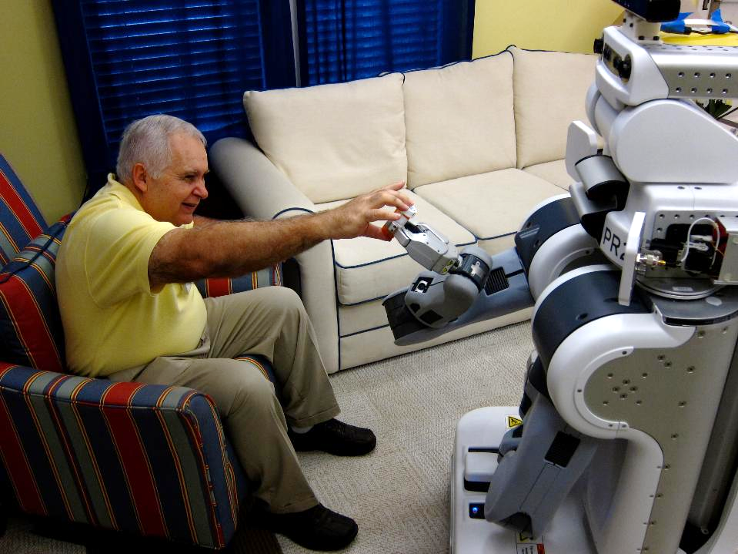
What is an Assistive Robot?
A robot that...
“gives aid or support
“to a human user”
Feil-Seifer and Mataric, 2005
Applications:
Cognitive Stimulation
Safety Monitoring
Physical Support
Notes:
Assistive robots are defined as robots that provide aid or support to users. The type of support they offer can vary widely - from physical assistance (like picking up objects) to cognitive or emotional support (such as engaging users in mental stimulation or conversation). These robots are designed to meet diverse needs across different populations, including older adults.

Slide 5
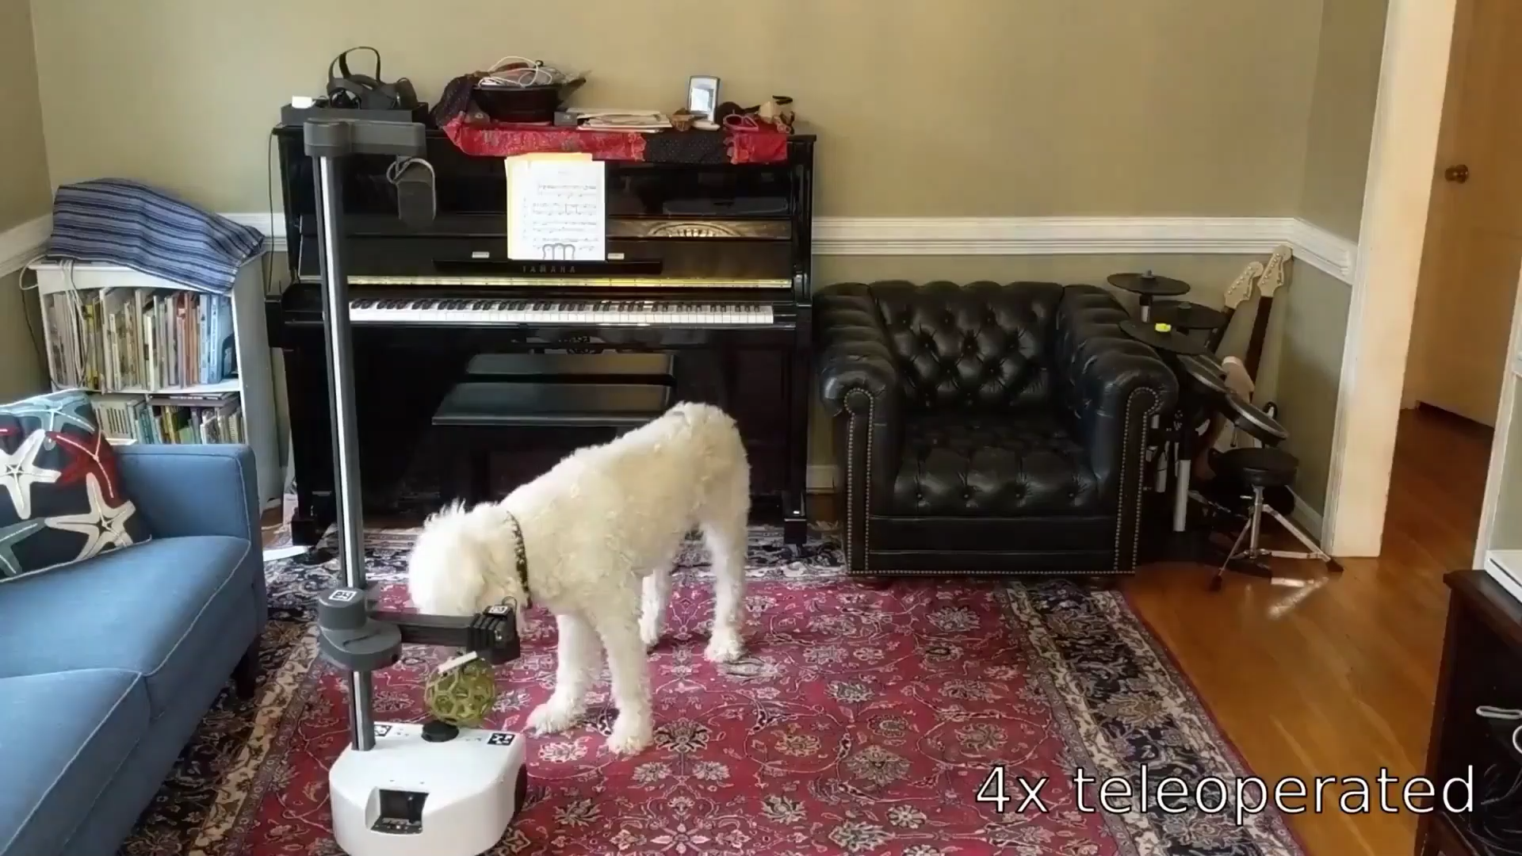
Assistive Robots in Action
Notes:
This short video showcases Stretch, an assistive robot, performing a variety of tasks. The demonstration offers a practical glimpse into how assistive technologies can support users in everyday activities. Visual examples like this help contextualize the diverse capabilities of assistive robots - from providing physical help to offering cognitive support.

Slide 6






Challenges of Accepting Assistive Robots
Cost
Usability
Unmet Needs
Trust
Notes:
While assistive robotics has advanced significantly, older adults still face several barriers to adoption:
- Cost: Commercially available assistive robots remain expensive - with even the more affordable models costing around $20,000 - and are rarely covered by insurance.
- Usability: Individuals with limited exposure to robotic technology may find these systems difficult to approach or operate.
- User Needs: Assistive robots may not always align with the real-world needs of users, highlighting the importance of continued research.
- Trust: Perhaps most importantly, independent and effective use of assistive robots relies on the user’s trust in the technology.
This presentation focuses on that final factor - trust - and its role in older adults’ acceptance of assistive robots.

Slide 7
TRUST:
The degree to which the user accepts to be vulnerable during the interaction, with the confidence that the robot will not harm them
“
”
Notes:
In this research, we define trust as the degree to which a user accepts to be vulnerable during the interaction with a robot with the confidence that the robot will not harm them.
This definition is based on established findings from prior studies in the field.

Slide 8
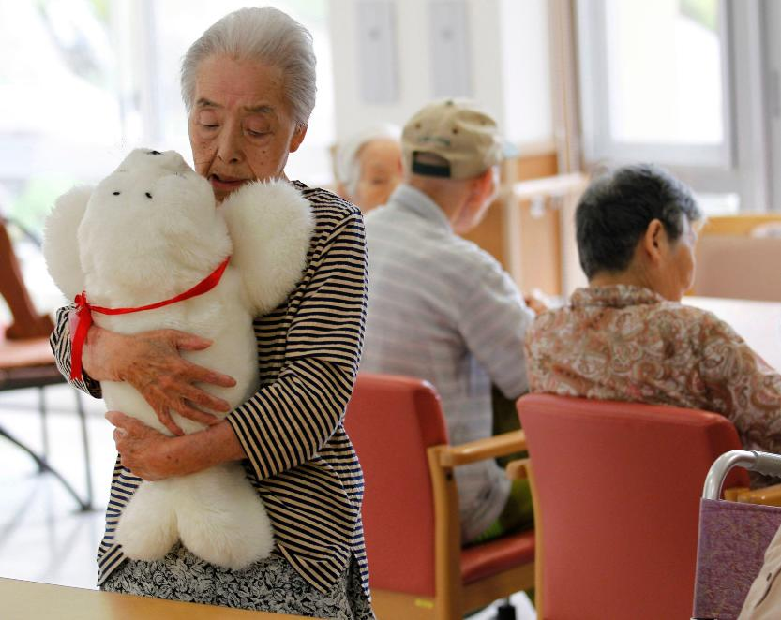
Primary Research Question
Does older adults' familiarity with robotic technologies impact their trust in assistive robots?
Notes:
My main question was: How does older adults’ familiarity with robotic technologies influence their trust in assistive robots?
This question guided our lab’s research, leading to three studies focused on diverse older adult groups.

Slide 9
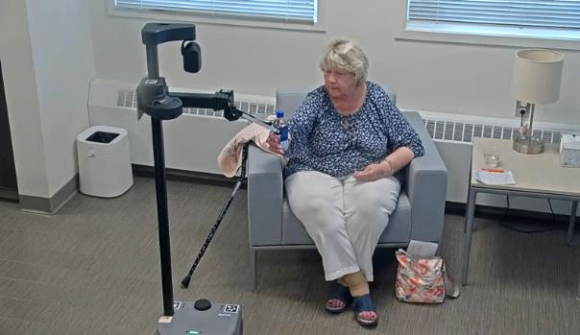
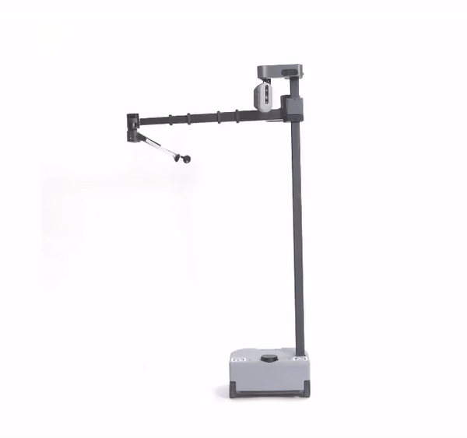
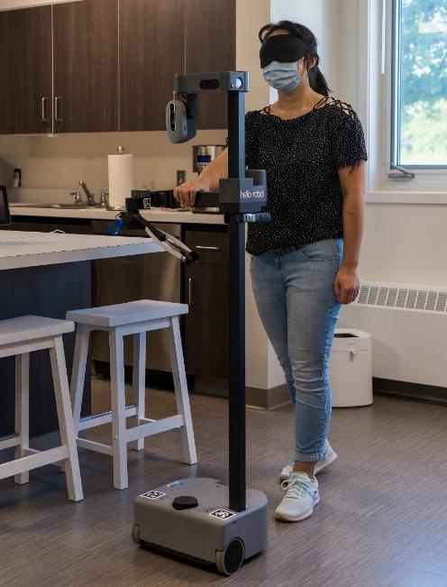
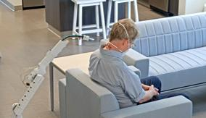
Assistive Robots in Context
Notes:
The first study used the Stretch robot to assist individuals with visual impairments in safely navigating a simulated home environment. Stretch, shown in the middle, is a mobile manipulator that can drive around a home and use its gripper to pick up and manipulate objects.
The second study involved a prototype telehealth robot called Soft Robot, designed for remote healthcare tasks like inspecting wounds, changing bandages, and reading medication labels. This robot is controlled remotely by healthcare professionals.
The final study also featured Stretch but focused on supporting people with mobility impairments.

Slide 10
Initial Data (N = 47)
Robot Familiarity and Use
13 different types of robots
(e.g., manufacturing, domestic, entertainment)
Likert Scale of 1-5:
Not sure what this robot is
Have used or operated this robot frequently
Mitzner et al., 2011
Robot Trust
Evaluating multiple dimensions of trust
(e.g., capability, accuracy, reliability)
Likert Scale of 1-5:
Strongly Disagree
Strong Agree
Ullman & Malle, 2018
Notes:
All three studies started with surveys assessing participants’ familiarity with 13 different types of robots—from manufacturing to domestic and entertainment—using a 1–5 Likert scale ranging from “Not sure what this robot is” to “Have used or operated this robot frequently” (Mitzner et al., 2011).
Participants then completed surveys measuring multiple dimensions of trust in assistive robots, including capability, accuracy, and reliability, on a 1–5 scale from “Strongly Disagree” to “Strongly Agree” (Ullman & Malle, 2018).
Across the studies, 47 unique older adult participants completed both surveys. This data helped us explore how familiarity with robotics relates to trust in assistive technology.

Slide 11
Method
Secondary Data Analysis
Data from user studies exploring the use of assistive robots in different contexts
Machine Learning Approach
Notes:
Next, I performed a secondary data analysis using the data from the three previously mentioned studies.
The goal was to develop a machine learning model to predict older adults’ willingness to trust a robot based on their familiarity with robotic technologies.

Slide 12
Data Analysis Process
Identifying suitable models
Least Squares Regression (LSR)
LASSO - Least Absolute Shrinkage and Selection Operator (L1)
Ridge (L2)
Detecting multicollinearity
High VIF indicates variables explain each other
Explanatory Variables (Familiarity with...) | VIF
Autonomous Car | 23
Home Robot | 20
Toy Robot | 32
Manufacturing Robot | 94
Military Robot | 58
Paro | 13
Remote Presence Robot | 7
Research Robot | 21
Lawn Mower Robot | 35
Guard | 17
Space Exploration Robot | 394
Surgical Robot | 191
Unmanned Robot | 23
Notes:
To build a linear predictive model, I explored three regression techniques: Least Squares, LASSO, and Ridge Regression. Least Squares works well only when explanatory variables don’t strongly relate to each other, a condition called multicollinearity.
Multicollinearity was measured using the variance inflation factor (VIF), where values over 10 indicate problematic multicollinearity. Our data showed high VIF values, making Least Squares unsuitable.
Both LASSO and Ridge regression handle multicollinearity effectively. LASSO tends to produce simpler, more interpretable models, while Ridge provides more detailed but slightly more complex results.
I applied both methods to predict different trust categories and compared their performance.

Slide 13
Results
Using LASSO and Ridge Regression Techniques to Predict:
Overall Trust
Capacity-based Trust
Relation-based Trust
Notes:
The trust questionnaire included 10 items measuring participants’ trust levels.
Using LASSO and Ridge regression models, I identified the strongest predictors of overall trust, as well as two key subcategories: capacity-based trust and relation-based trust.

Slide 14
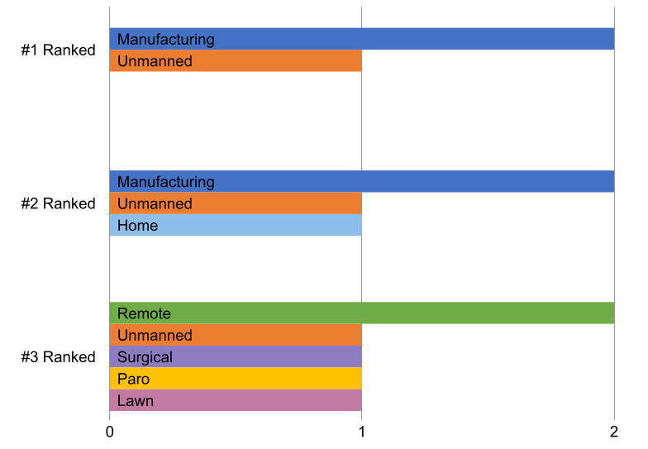
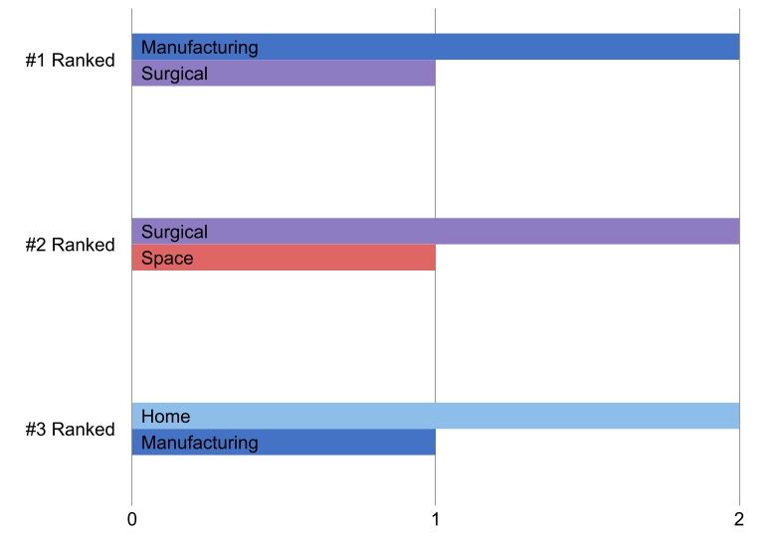
Familiarity with these Robots Impacted Trust
Top 3 Influential Variables from LASSO
Top 3 Influential Variables from Ridge
Notes:
By combining results from six regression analyses, key patterns emerged. Familiarity with manufacturing robots was a strong predictor of trust in both LASSO and Ridge models.
Unmanned robots were important in LASSO models but not in Ridge, while surgical robots had greater influence in Ridge models compared to LASSO. These differences highlight how each method weighs factors differently.

Slide 15
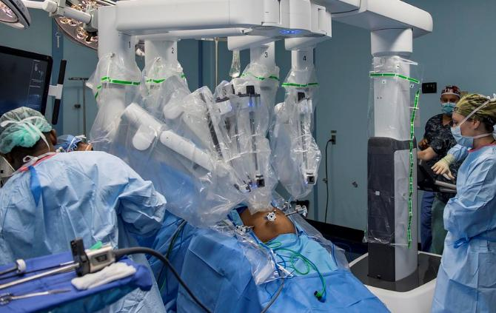
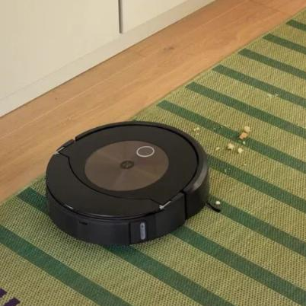
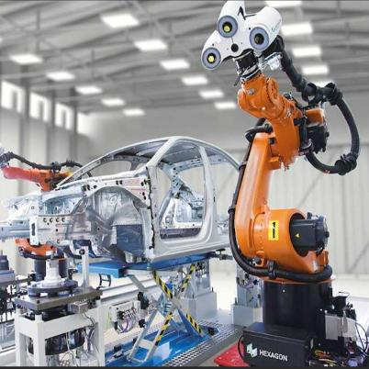
Discussion
Top predictors of Older Adults’ willingness to trust assistive robots include...
Familiarity with:
Manufacturing robots
Unmanned robots
Home robots
Surgical robots
Surgical Robot
Home Robot: Vacuum
Manufacturing Robot
Notes:
The strongest predictors of older adults’ trust in assistive robots were their familiarity with manufacturing, unmanned, home, and surgical robots.
While these findings offer valuable insights, the analysis was based on a small sample of 47 participants across three studies. More research is needed to confirm and expand on these results.

Slide 16
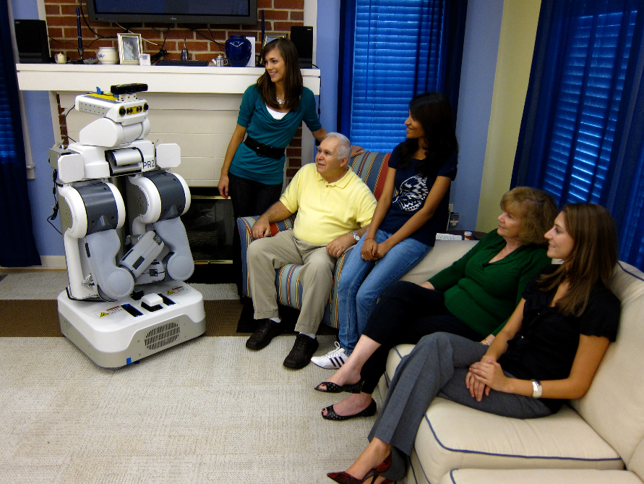
Next Steps
Expand dataset
Data cleaning
Other ML models
More demographics
Factors beyond robot familiarity
Better measures of trust (qualitative + quantitative)
Notes:
Expand the dataset to include more studies that use the same familiarity and trust questionnaires
Once there is a significant amount of data, more thorough data cleaning can be performed to deal with outliers and any irregularities
Other regression techniques including non-linear methods can be employed to see if they improve the accuracy of the model.
Potentially Expand beyond just older adults and include different age demographics.
Explore different influential factors beyond familiarity – such as media presence
There are also other ways of measuring trust, such as analyzing body language or facial expressions. Using these metrics may provide more accurate results.

Slide 17
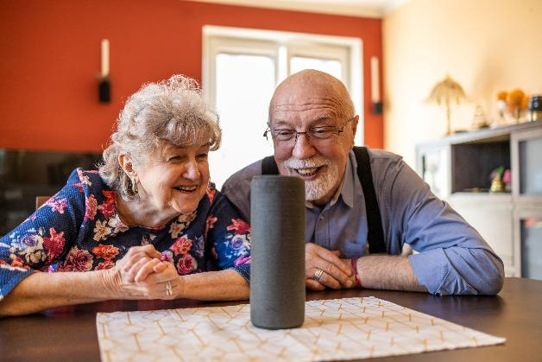
Concluding Thoughts
Engagement in participatory design...
builds familiarity
identifies gaps in trust
Increasing awareness of assistive tech could...
improve trust
promote user acceptance
Designing robot communication with users’ familiarity in mind can help foster trust and accelerate acceptance during interactions.
Notes:
Involving older adults in research and the design process can increase their familiarity with robotic technologies - ultimately shaping their willingness to trust.
Beyond design, simply improving exposure and awareness may support greater acceptance of assistive robots.
As familiarity and exposure grow, designing robots with clear and approachable communication methods will be key to building trust.
Ultimately, understanding this relationship helps guide the development of robots that are not only functional, but meaningfully accepted by those they’re meant to assist.

Slide 18
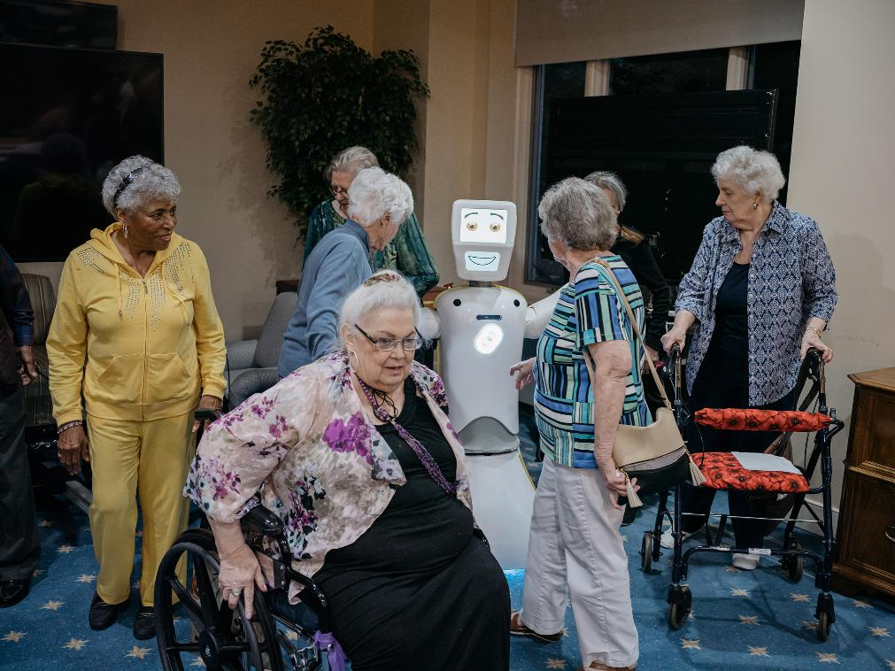
Overarching Goal
A future in which older adults trust assistive robots
Notes:
As we deepen our understanding of how older adults perceive assistive robots, we can continue improving their design and integration.
It’s important to emphasize that these technologies are not meant to replace human care, but to complement it - like the Soft Robot, which is operated by trained healthcare professionals.
The ultimate goal is a future where older adults can confidently trust and rely on assistive robots as a part of their broader care network.
So, I’ll leave you with one final question: Would you trust an assistive robot to care for you?

Slide 19
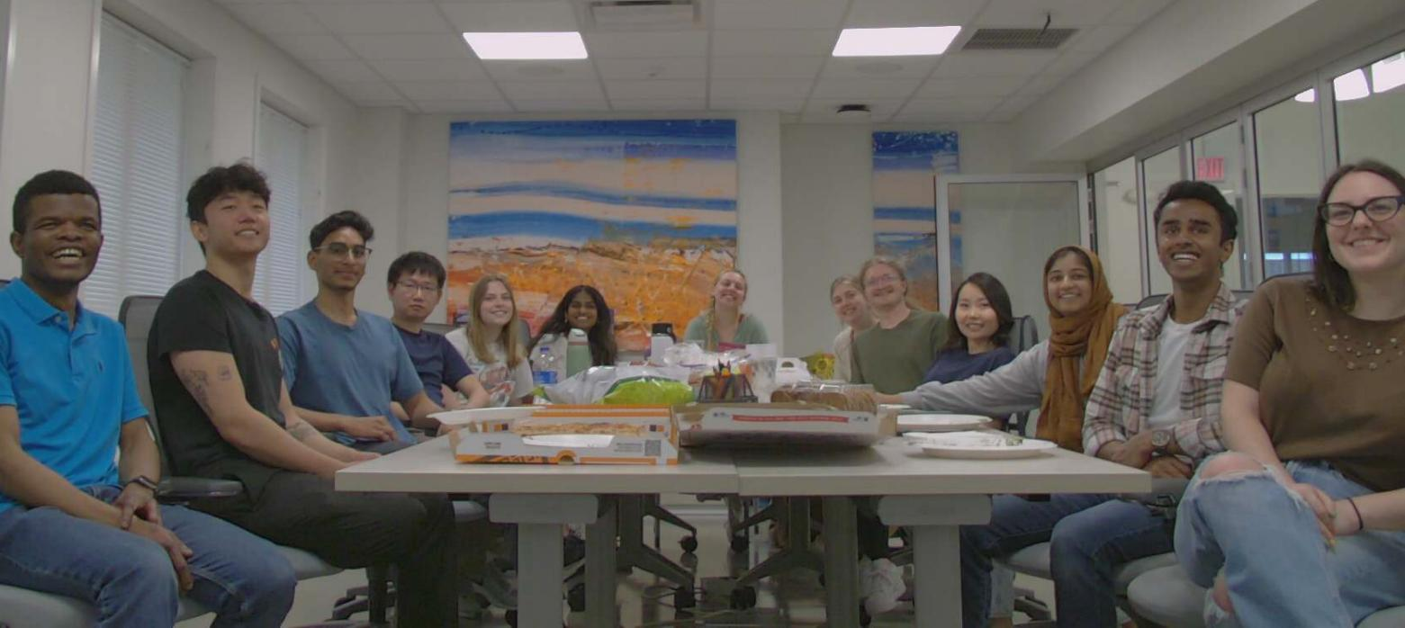
Thank You!
Notes:
Thank you to my research mentors, Dr. Samuel Olatunji and Dr. Wendy Rogers, as well as my team at the Human Factors and Aging Lab, for their support and guidance throughout this project.
If you’re interested in learning more about this work or exploring the intersection of aging and technology, feel free to reach out or visit my portfolio at saathveek.com for updates.

Slide 20
References
AARP. (2021). Home and community preferences of the 45+ population. https://www.aarp.org/home-family/your-home/info-2021/home-and-community-preferences-survey.html
Mitzner, T. L., Smarr, C.-A., Beer, J. M., Chen, T. L., Springman, J. M., Prakash, A., Kemp, C. C., & Rogers, W. A. (2011). Older adults’ acceptance of assistive robots (HFA-TR-1105). Atlanta, GA: Georgia Institute of Technology, School of Psychology, Human Factors and Aging Laboratory. Retrieved from http://hdl.handle.net/1853/39671
Ullman D., Malle B. F. (2018). What Does it Mean to Trust a Robot?: Steps Toward a Multidimensional Measure of Trust. ACM/IEEE International Conference on Human-Robot Interaction. https://doi.org/10.1145/31
United Nations. (2017). World population ageing 2017: Highlights. Department of Economic and Social Affairs, Population Division. https://www.un.org/en/development/desa/population/publications/pdf/ageing/WPA2017_Highlights.pdf
U.S. Census Bureau. (2021). Population estimates and projections. https://www.census.gov/programs- surveys/popest.html
U.S. Department of Health and Human Services. (2020). Older Americans 2020: Key indicators of well-being. Administration for Community Living, Administration on Aging. https://acl.gov/sites/default/files/aging%20and%20Disability%20In%20 America/2020Profileolder americans.final.pdf
Urban Institute. (2021). U.S. population aging. Data Warehouse: What the Future Holds. https://www.urban.org/policy-centers/cross-center-initiatives/program-retirement-policy/projects/data-warehouse/what-future-holds/us-population-aging

Slide 22
Supplementary Videos
The following slides show 3 assistive robots across various use-cases.

Slide 23
Notes:
Strech interacting and performing various tasks.

Slide 24
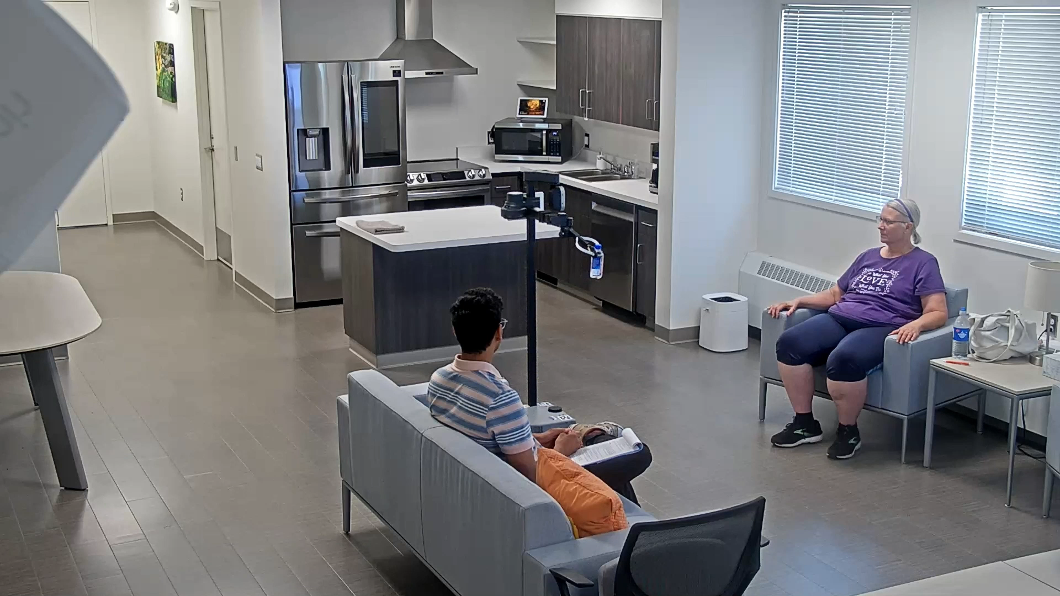
Notes:
Stretch approaching a participant, delivering a bottle of water, then returning to its resting position.

Slide 25
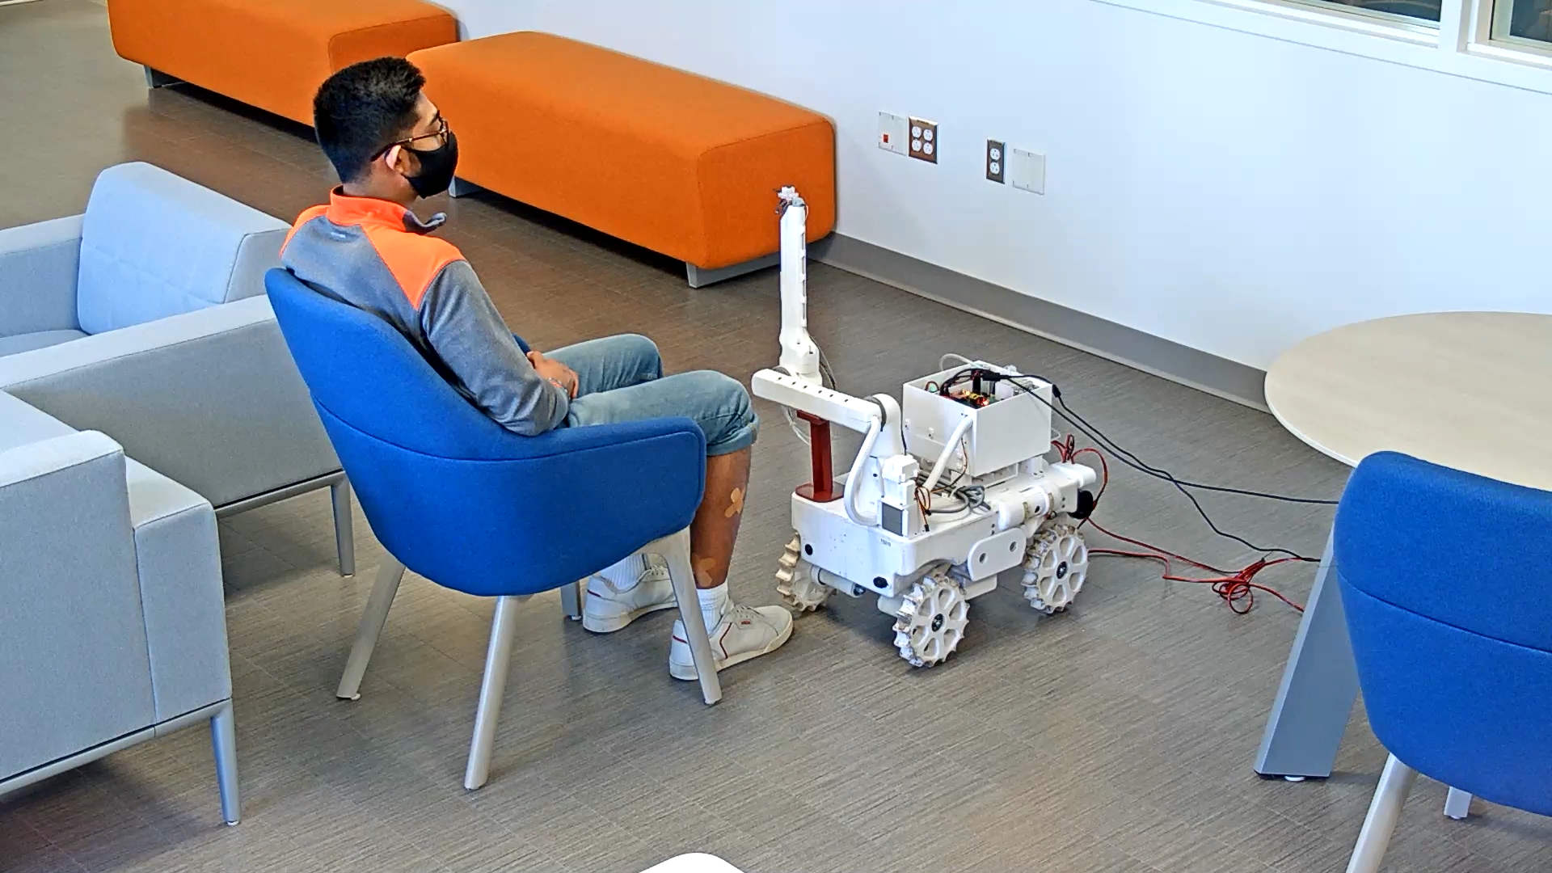
Notes:
Soft arm robot prototype being used to remotely inspect bandages on a study participant.

Slide 26
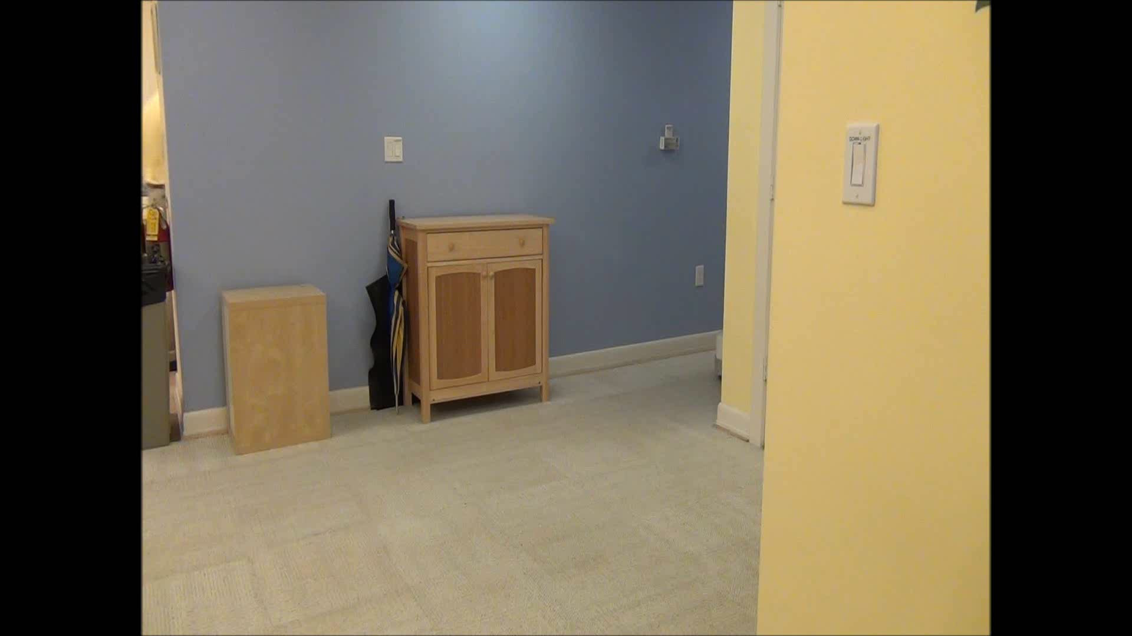
Notes:
Personal Robot 2 (PR2) interacting with a participant.

